Slide 1
Selective Inference
Nov. 4, 2022
Gwangwoo Kim

Slide 2
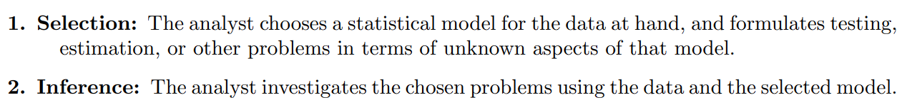
Introduction
Remark: Choices about which model to use, hypothesis to test, or parameter to estimate, are made before seeing the data.

Slide 3
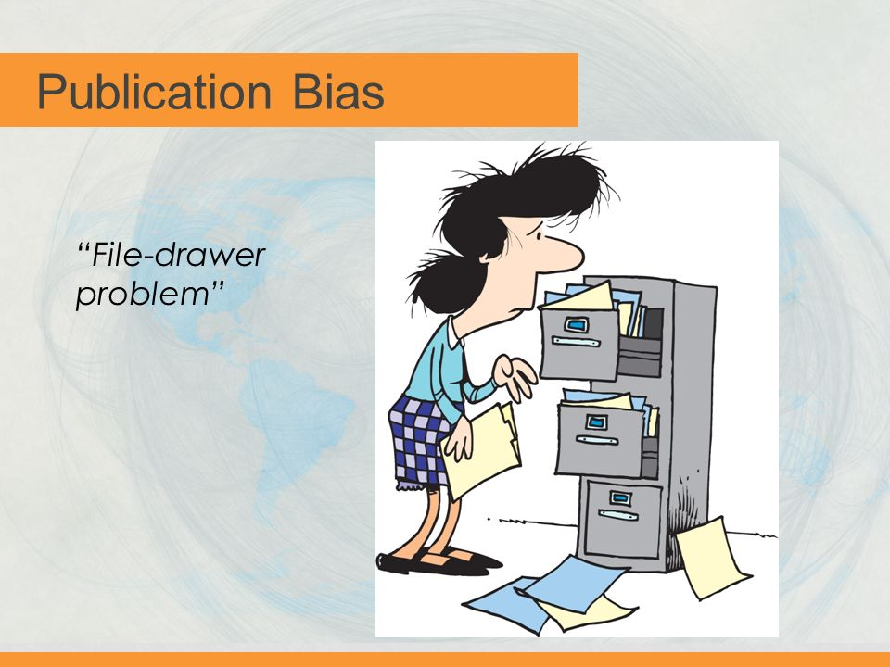
Introduction

Slide 4






Introduction
File Drawer Effect:
Suppose for i=1,2,…,n. We focus only on the large effects
Now, we wish to test test for such indices at level 0.05.
The test that rejects the null hypothesis when is invalid, even though the probability of falsely rejecting a given null hypothesis is still
The true type I error is . This value is about 0.16.
In this case, we must use 2.41 in place of 1.96 so that becomes 0.05.

Slide 5

Introduction
Nominal type I error rate:
The selective type I error rate:
Remark: If the randomness in selecting the model and the hypothesis is independent of the data
sed for inference, they are the same.
Example: Split the data into two chunks (say X and Y) and assume they are independent.
Then we can imitate the scientific process by setting aside X for selection and Y for inference.
In that case, the nominal test can also control the selective error.

Slide 6





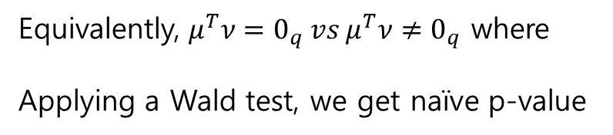
Introduction
Suppose
We’d like to test
Equivalently, $μ^{T}ν=0_{q} vs μ^{T}ν≠0_{q}$ where
Applying a Wald test, we get naïve p-value

Slide 7
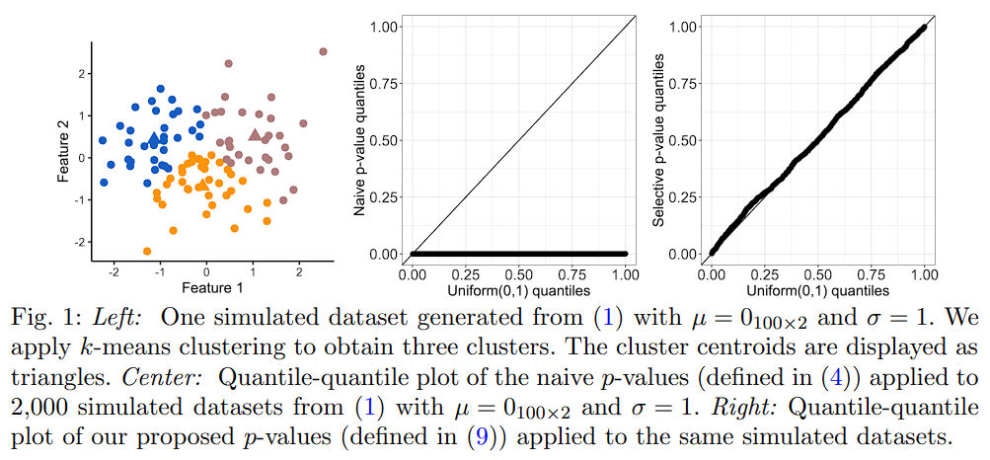
Introduction

Slide 8
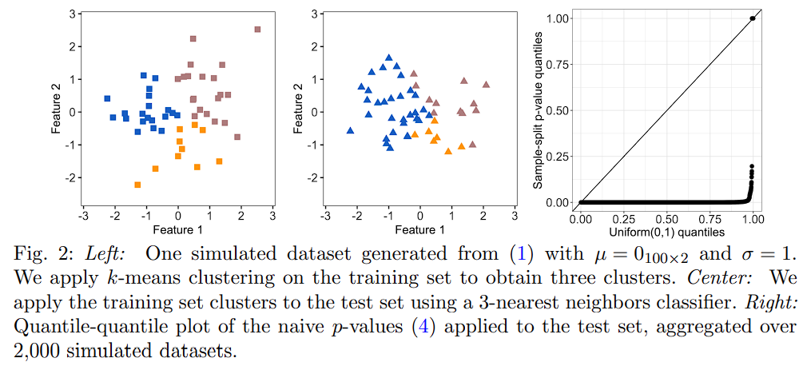
Introduction

Slide 9


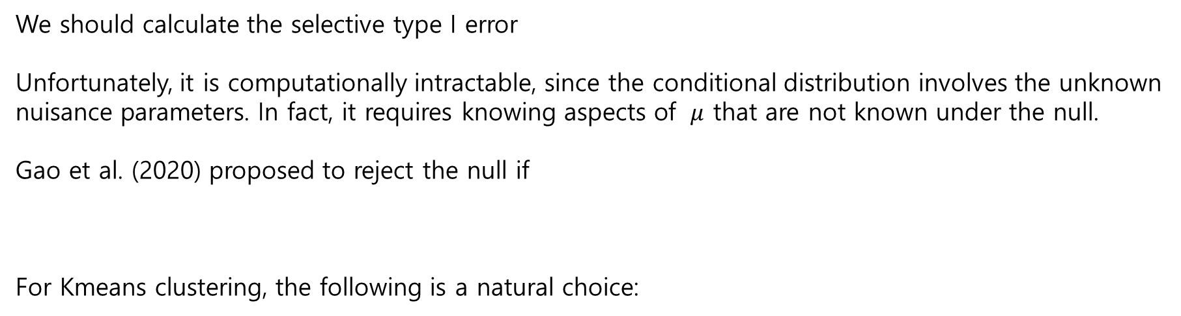
Related work
We should calculate the selective type I error
Unfortunately, it is computationally intractable, since the conditional distribution involves the unknown
nuisance parameters. In fact, it requires knowing aspects of $μ$ that are not known under the null.
Gao et al. (2020) proposed to reject the null if
For Kmeans clustering, the following is a natural choice:
is small
It may necessitate enumerating over possibly an exponential number of intermediate cluster assignments

Slide 10
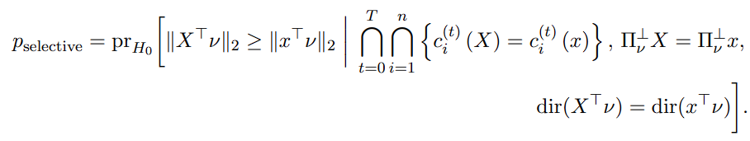
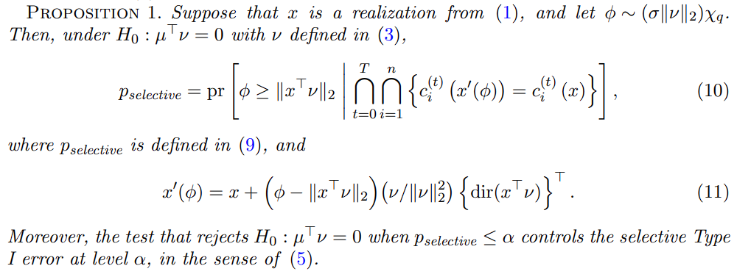
Selective inference
every iteration of the k-means algorithm

Slide 11
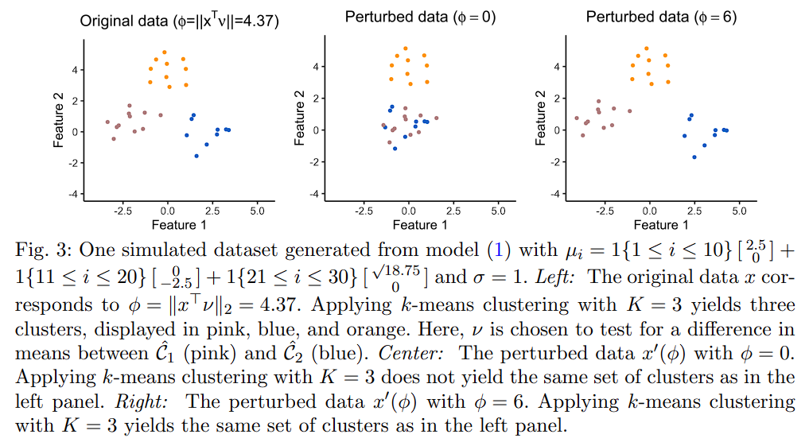

Selective inference

Slide 12


Computation of the selective p-value
So on
This condition can be expressed using K-1 inequalities.

Slide 13
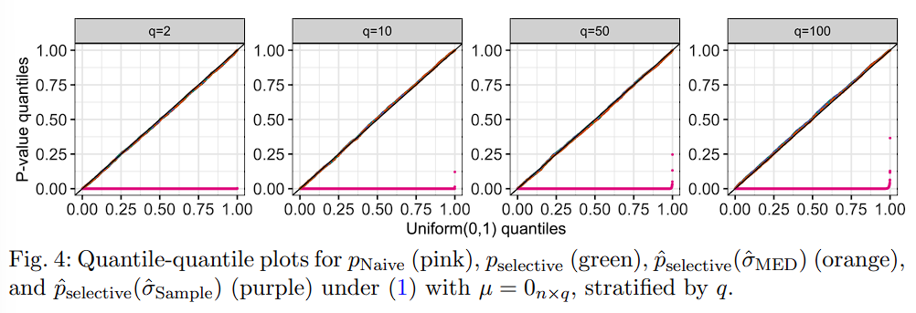
Simulation

Slide 14
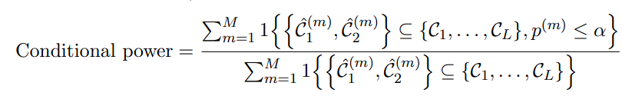

Conditional power and detection probability

Slide 15
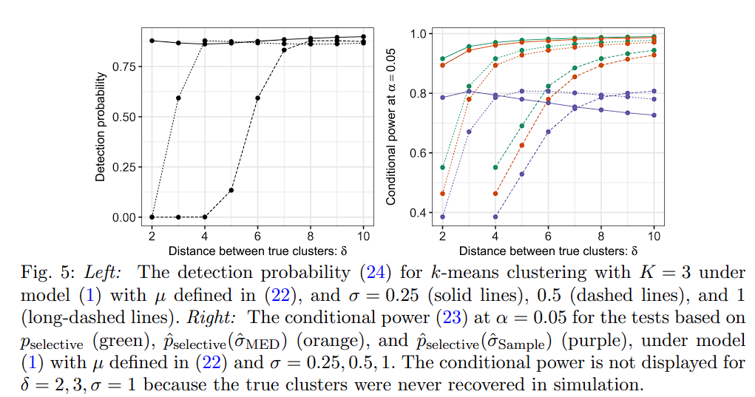
Conditional power and detection probability

Slide 16
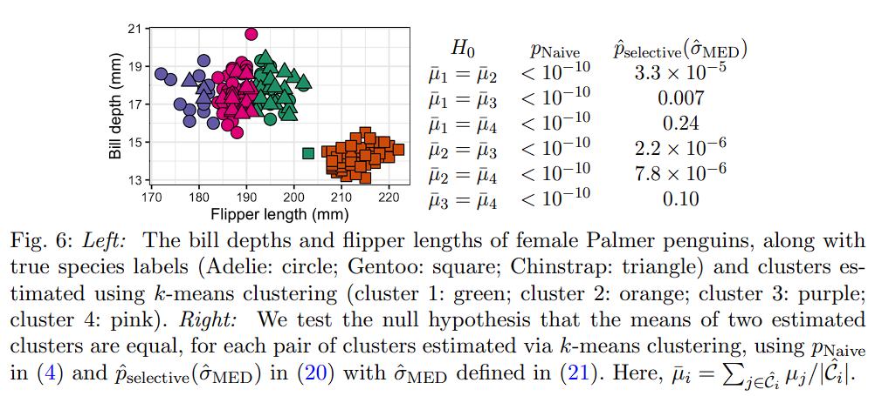
Real data applications

Slide 17
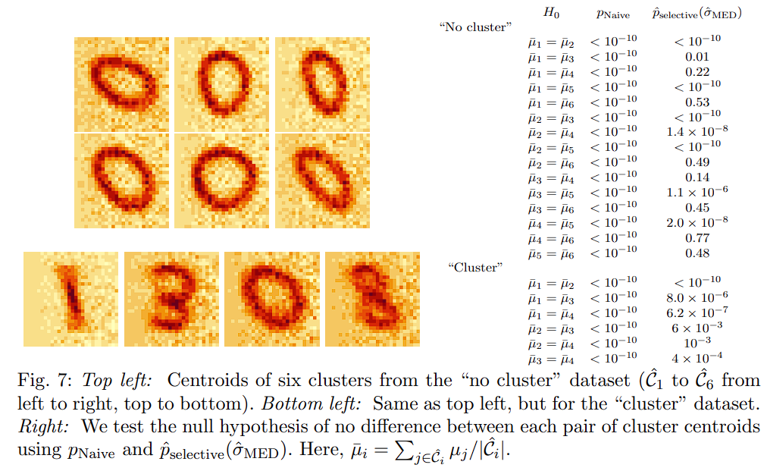
Real data applications

Slide 18
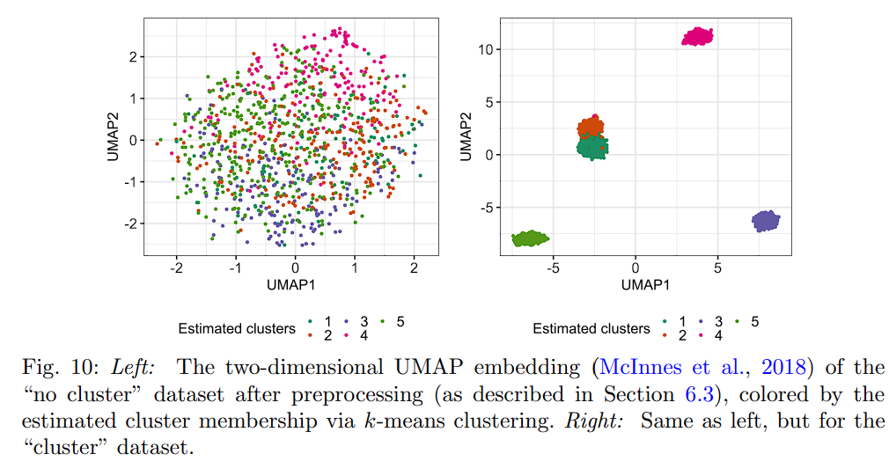
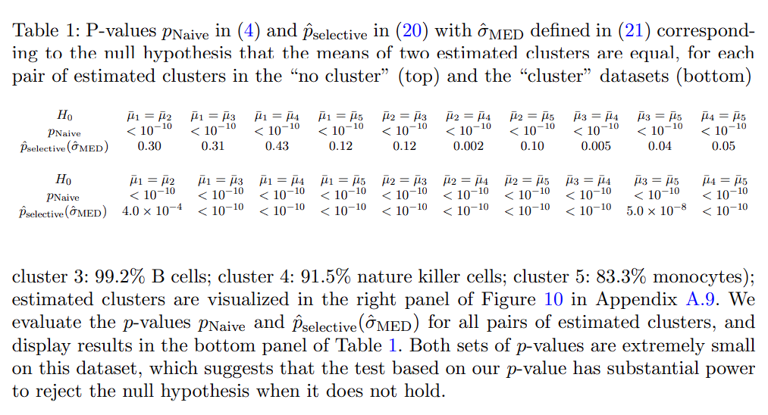
Real data applications

